Slide 1
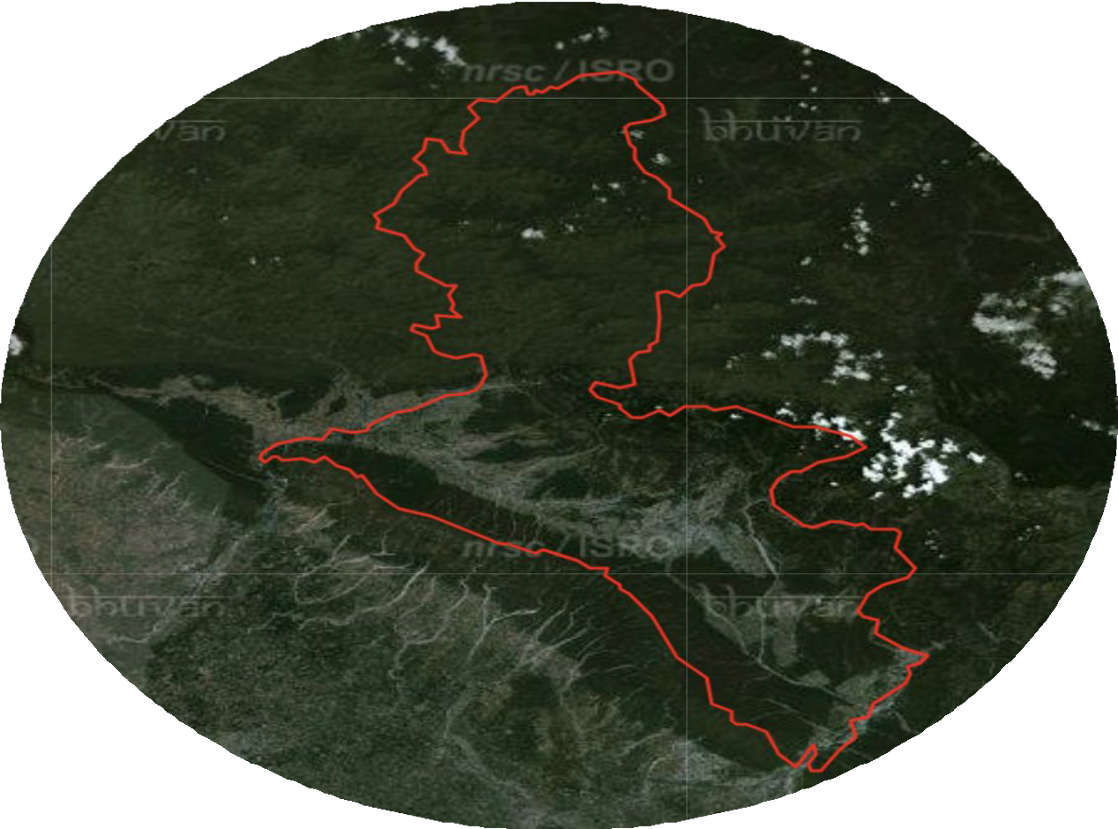
DEFORESTATION MAPPING USING SATELLITE IMAGES
Dehradun
UNDER THE SUPERVISION
DR. RAMESH KUMAR

Slide 2
INTRODUCTION
Deforestation is a critical environmental issue that significantly impacts biodiversity, climate change, and human livelihoods.
Accurate mapping and monitoring of deforestation are essential for effective forest management and conservation strategies.
This project aims to develop a comprehensive deforestation mapping approach focusing on Dehradun, a district in India known for its rich forest cover.
The primary objective is to analyze changes in forest cover over a one-year period, from 2015 to 2020, using remote sensing and advanced geospatial techniques.

Slide 3
Progression and Comparative Analysis of Deforestation Data (2015 vs 2020)
Analysis of 2015 Data
Detailed deforestation analysis was conducted on 2015 data in the pervious semester.
Outcomes provided insights into key deforestation trends.
Analysis of 2020 Data
Currently applying the same methodology to 2020 data.
Ensures consistency in the approach for the accurate comparison.
3. Comparison of Outcomes
Results from 2015 and 2020 data will be cpmpared
Aim to identify patterns, trends, and changes in deforestation.
Insights will guide understanding of deforestation progression over time.

Slide 4
MOTIVATION
Deforestation poses a significant threat to ecosystems, biodiversity, and climate stability.
Traditional monitoring methods have limitations in coverage, frequency, and accuracy.
Integration of satellite imagery and deep learning offers a promising solution.
Satellite images provide real-time, high-resolution data for detecting changes in land cover.
Deep learning algorithms automate the analysis of large datasets, enhancing precision in deforestation mapping

Slide 5
OBJECTIVES
Algorithm specific model training and optimization:
K-Mean: Train and optimize K-Means clustering algorithms to identify distinct cluster of deforested and non- deforested area.
Random forest: Develop a random forest classifier using labelled satellite image to accurately classify deforestation pattern.
ISO Clustering: Implement the ISO Clustering algorithm to automatically detect clusters in satellite data.
MLC: Utilize maximum likelihood classifier to model the probability distribution of deforested and non- deforested classes and perform classification based on these probabilities.

Slide 6
OVERVIEW
The project will follow a systematic approach involving:
Data collection: through sentinel-2, Copernicus.
Preprocessing: through SNAP , atmospheric correction.
Composing band: merge band (2,3,4,8) through Arc GIS.
Mosaic: merge three tiles through Arc GIS.
Masking: extracting Dehradun shape through mosaic raster.
Creating training data.
Classification: K-means, ISO Clustering, Random forest, MLC (Most Likelihood Classification).

Slide 7
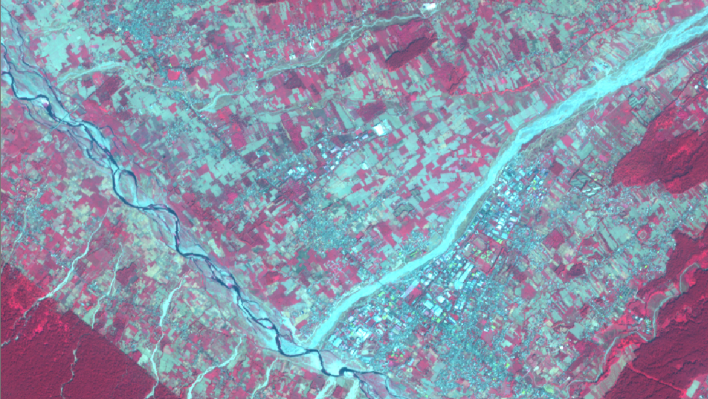
SOLUTION

Slide 8
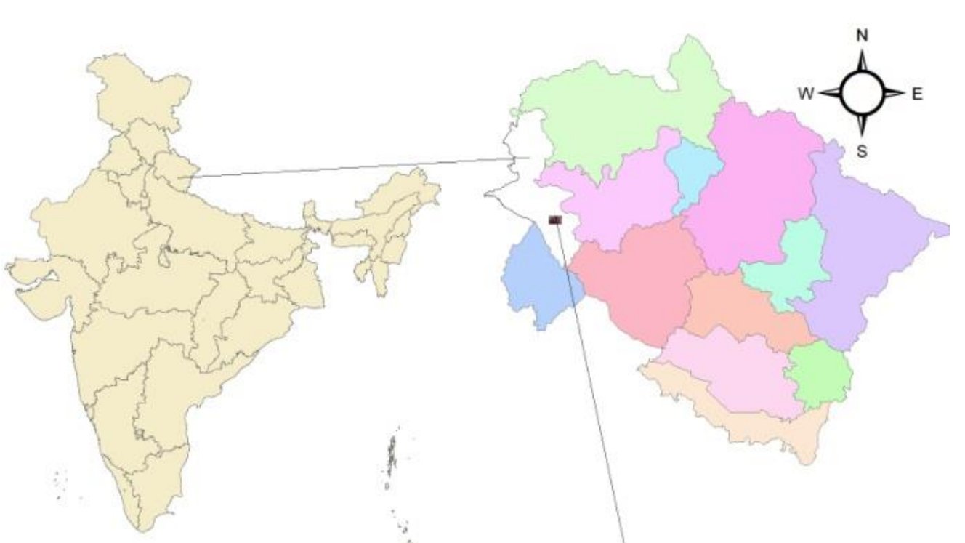
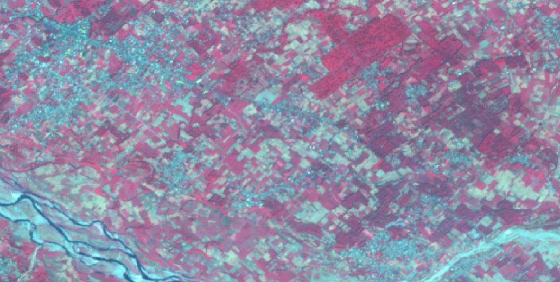
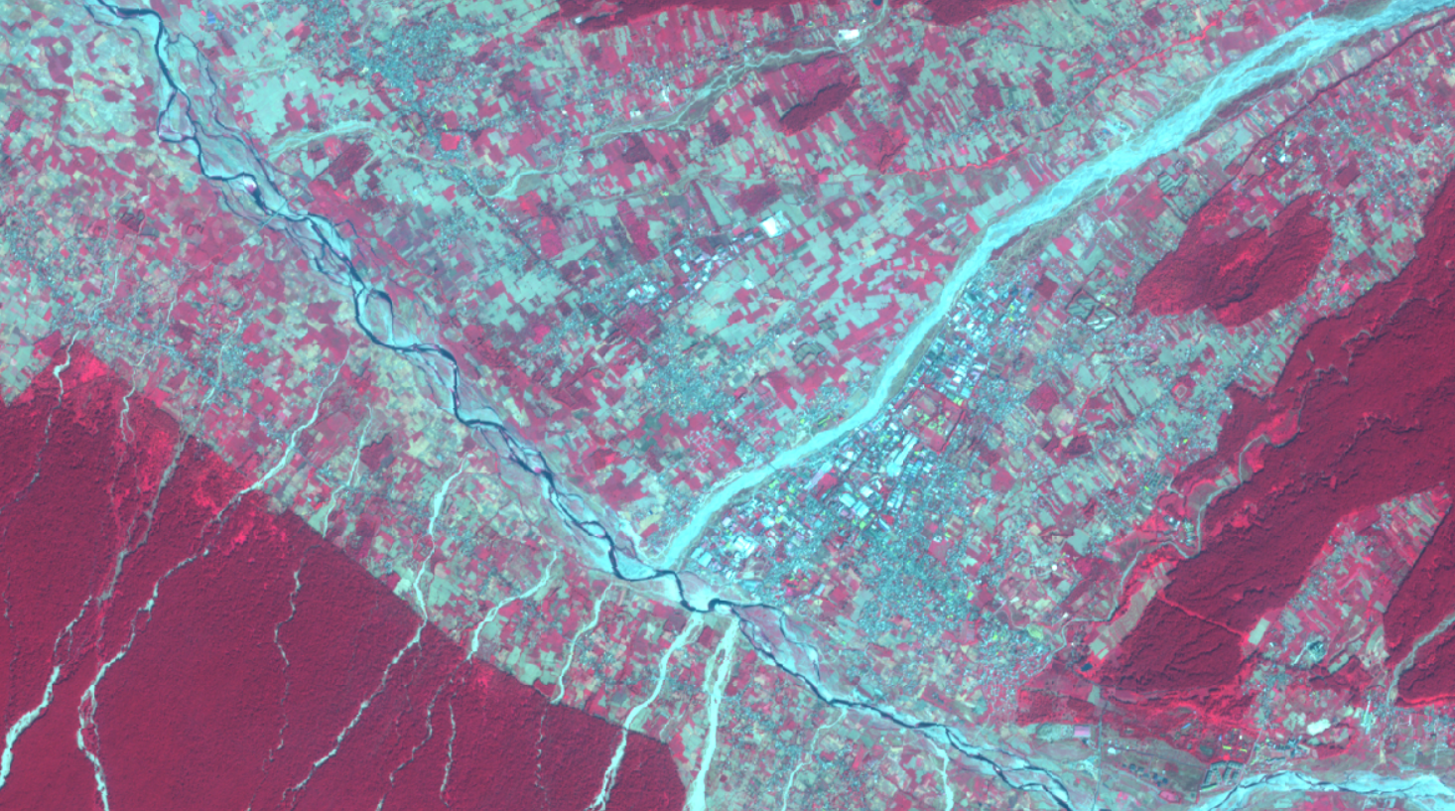
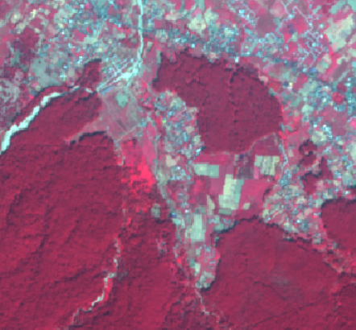
Processing of sentinel-2 data
Composite of Sentinel-2 image

Slide 9
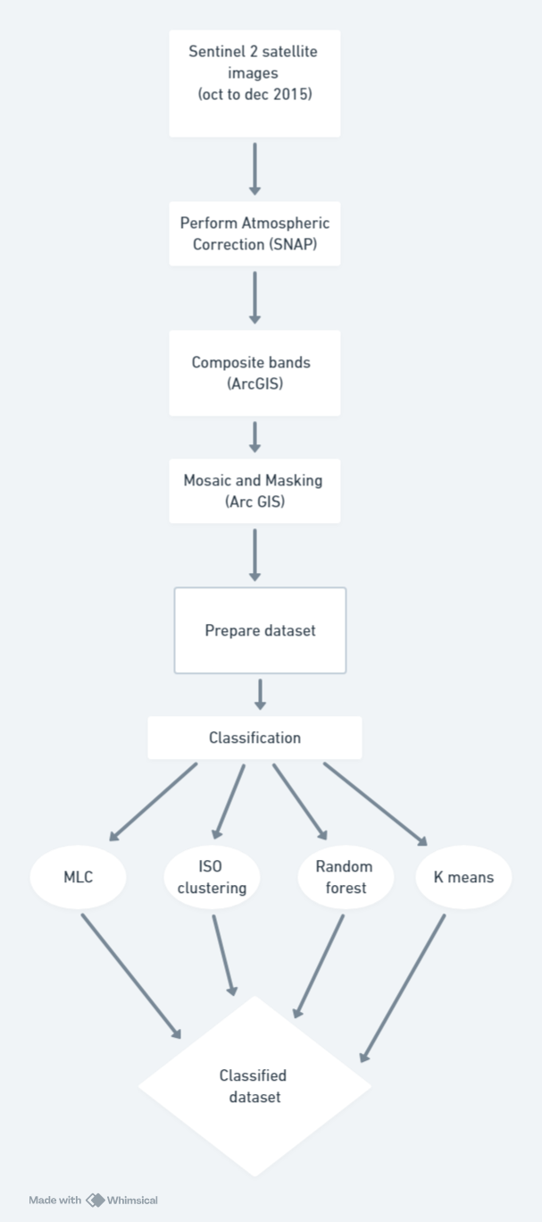
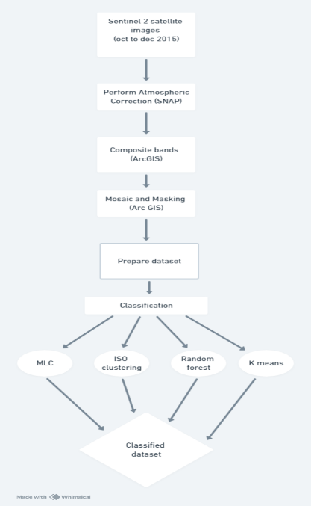
Sentinel 2 satellite images (oct to dec 2020)
FLOW CHART

Slide 10
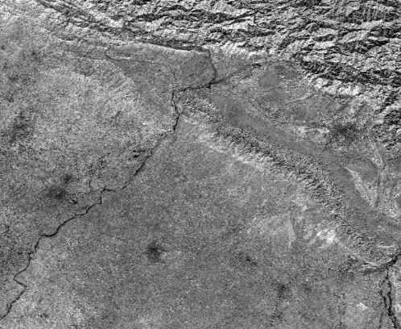
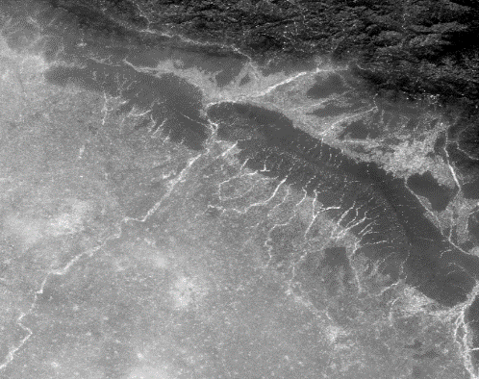
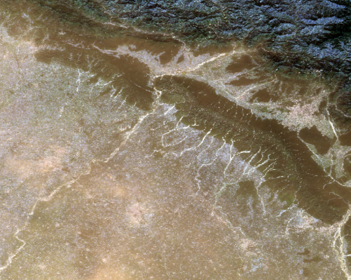
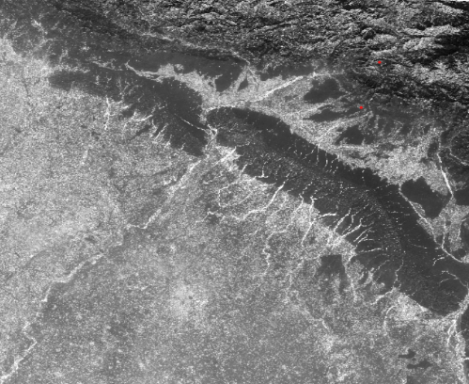
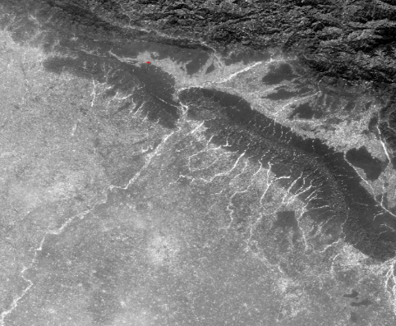
BAND 8
BAND 4
COMPOSITION
BAND 3
BAND 2

Slide 11
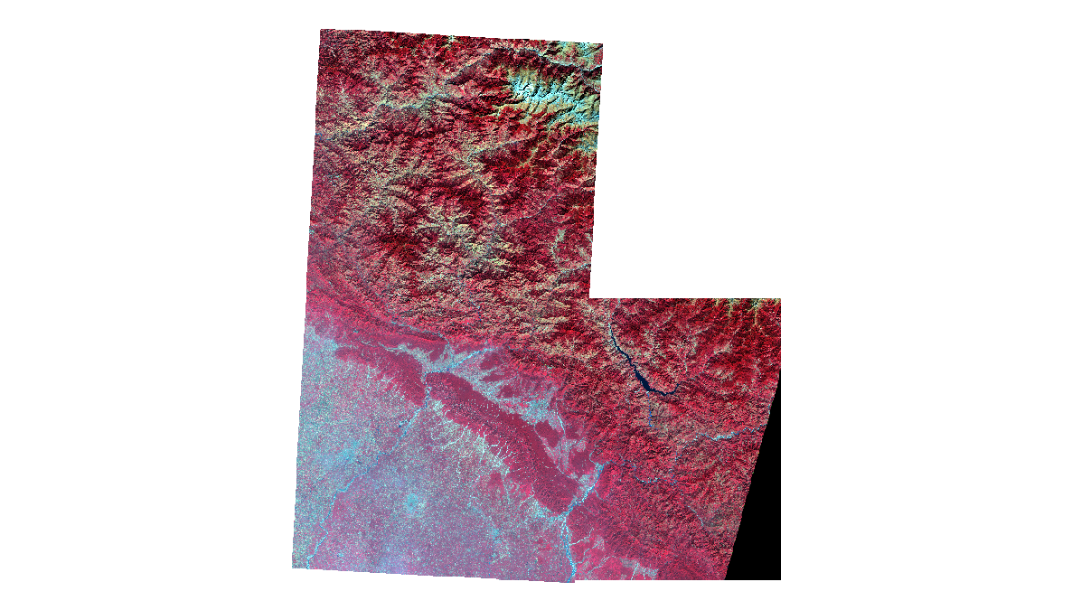
MOSAICKING

Slide 12
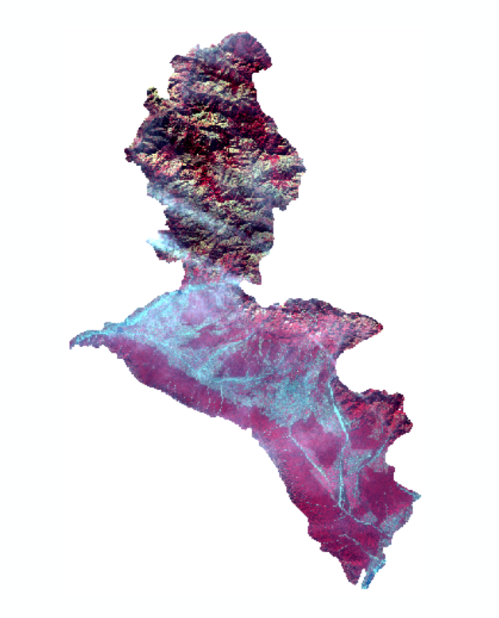
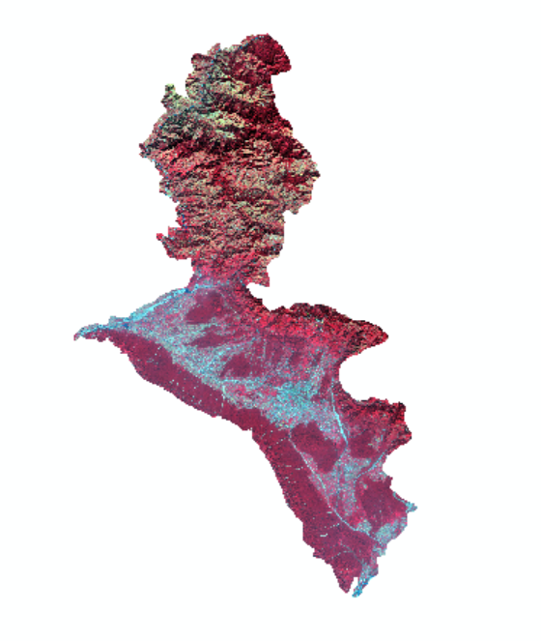
MASKING
2015
2020

Slide 13
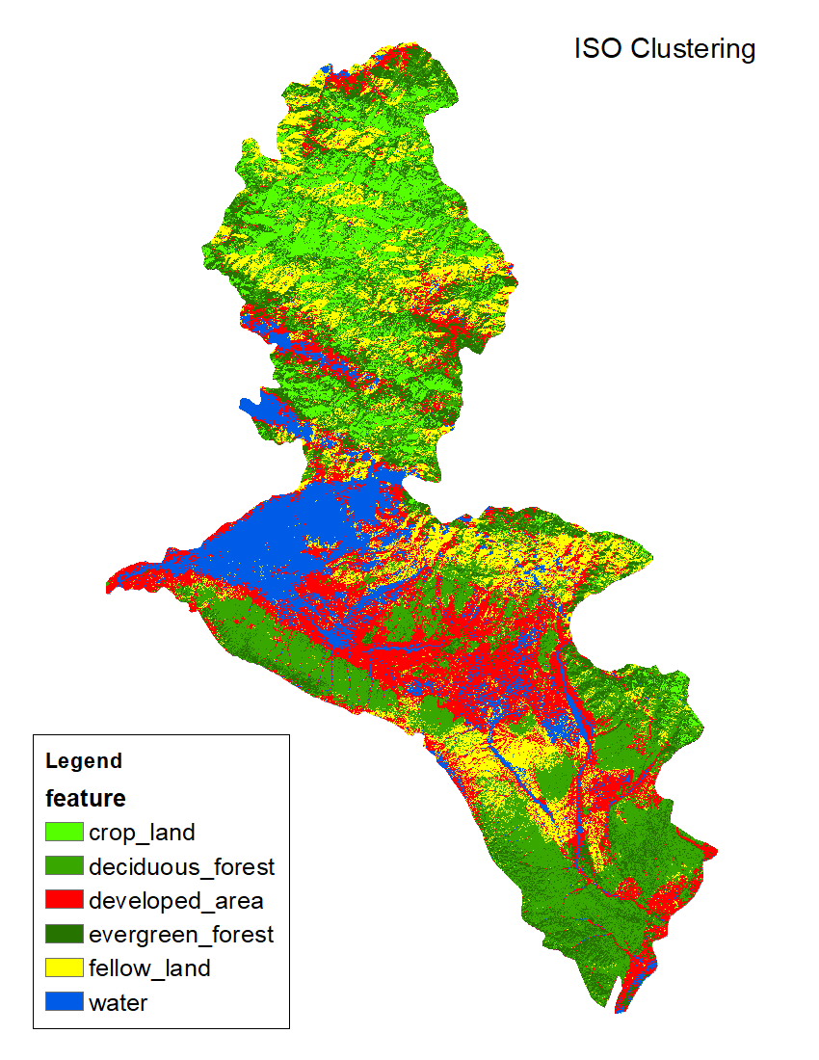
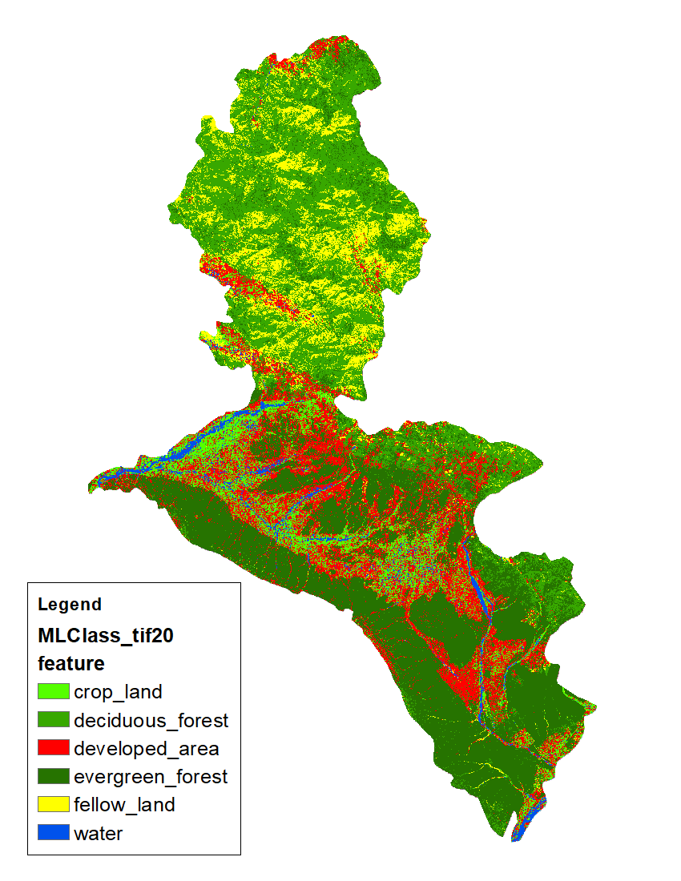
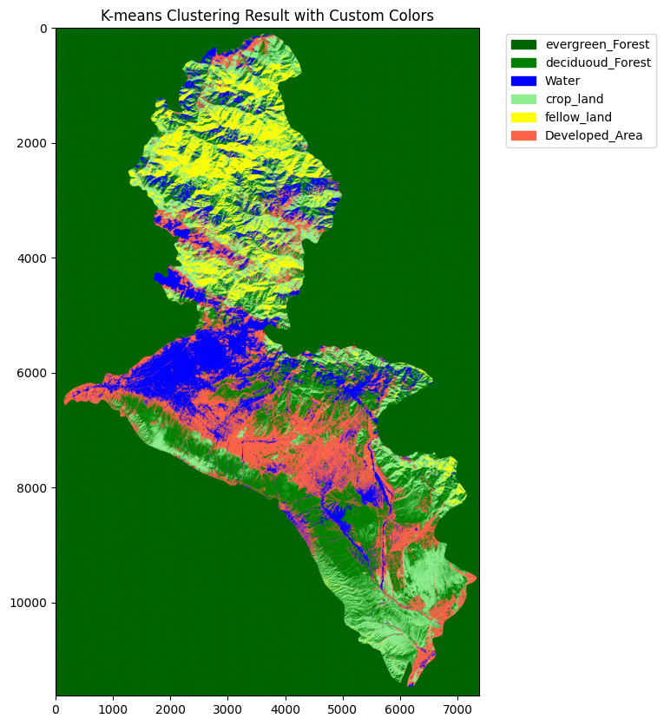
MLC

Slide 14
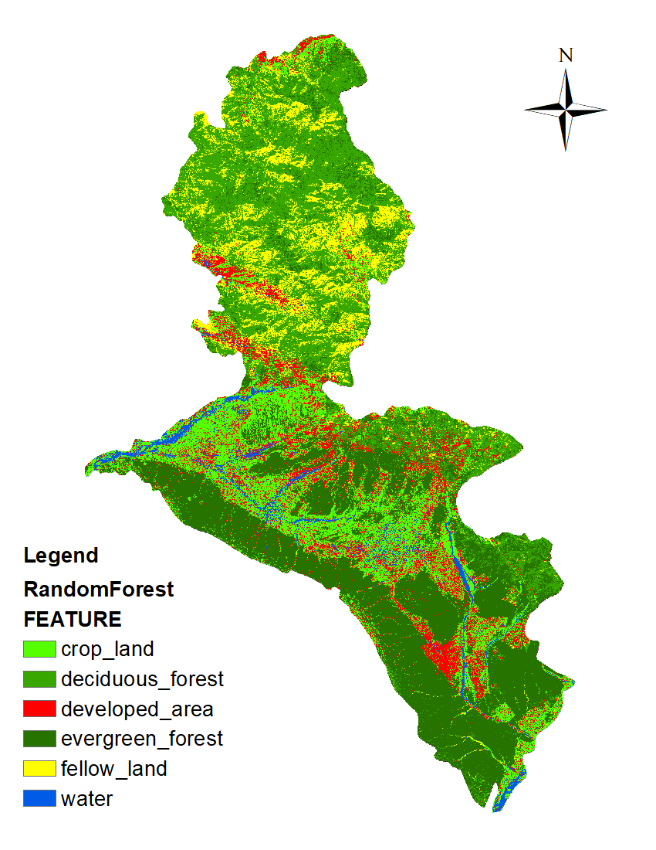
2015
MLC
Random Forest

Slide 15
2020
MLC
Random Forest

Slide 16
COMPARATIVE ANALYSIS OF DEFORESTATION: 2015 vs 2020
2015
2020

Slide 18
OUTCOMES
Utilize advanced satellite imagery and deep learning algorithms.
Generate highly detailed maps of deforestation patterns and hotspots.
Identify priority areas for conservation and intervention.
Contribute to understanding drivers and dynamics of deforestation.
Serve as valuable resources for policymakers, researchers, and communities.
The results highlight the difference in deforestation patterns between 2015 and 2020.
This comparison helps identify trends,underlying causes,and the overall impact of deforestation during the studied period.

